Slide 1
DIGITAL PORTFOLIO
.
NAME : EZHIL KUMAR E
REGISTER NO &NMID : 24131041802521010 & asanm10424cs02
DEPARTMENT : Bsc COMPUTER SCIENCE
COLLEGE : JAWAHAR SCIENCE COLLEGE

Slide 2
PROJECT TITLE :
SIMPLE
AUDIO
PLAYER

Slide 3
AJENDA
Problem Statement
Project Overview
End Users
Tools and Technologies
Portfolio design and Layout
Features and Functionality
Results and Screenshots
Conclusion

Slide 4
PROBLEM STATEMENT
The Challenge:
Users need a simple, intuitive way to interact with audio files.
Existing solutions are often too complex, with cluttered interfaces and unnecessary features for basic use.
This makes it difficult for a casual user to quickly play, pause, or share an audio file without a steep learning curve.

Slide 5
Project Overview
Our Solution :
We've developed a user-friendly audio player that focuses on simplicity and core functionality.
The goal of this project is to provide an accessible and streamlined experience for playing audio content.
This application provides a clean interface with essential controls, making it easy for anyone to use.

Slide 6
End Users
Who We're Building For :
Casual listeners: People who just want to quickly play a song or recording without complex settings.
Students: Users who need to listen to lectures or audio notes and require basic playback controls.
Developers: Individuals who need a lightweight tool to test audio files for their own projects.

Slide 7
Tools and Technologies
My Tech Stack
Frontend: HTML, CSS, JavaScript
Libraries: [List any specific libraries you used, e.g., React, a specific audio library]
Backend: [If your project has one, mention it here, e.g., Node.js]
Deployment: [Where did you host it, e.g., GitHub Pages, Netlify]

Slide 8
Portfolio design and Layout
User-Centric Design :
Clean Interface: The design prioritizes simplicity with a minimalist aesthetic.
Key Components: A main play/pause button, a seek bar, and a time display.
Intuitive Layout: Controls are placed in logical positions for quick and easy access.

Slide 9
Features and Functionality
Core Features
Audio Playback: Plays standard MP3 files.
Play/Pause Control: A large, obvious button to start and stop the audio.
Seek Bar: Allows users to scrub through the audio to any point.
Time Display: Shows both the current playback time and the total duration.
File Selection: A simple "Choose file" button to load audio from the user's device.

Slide 10
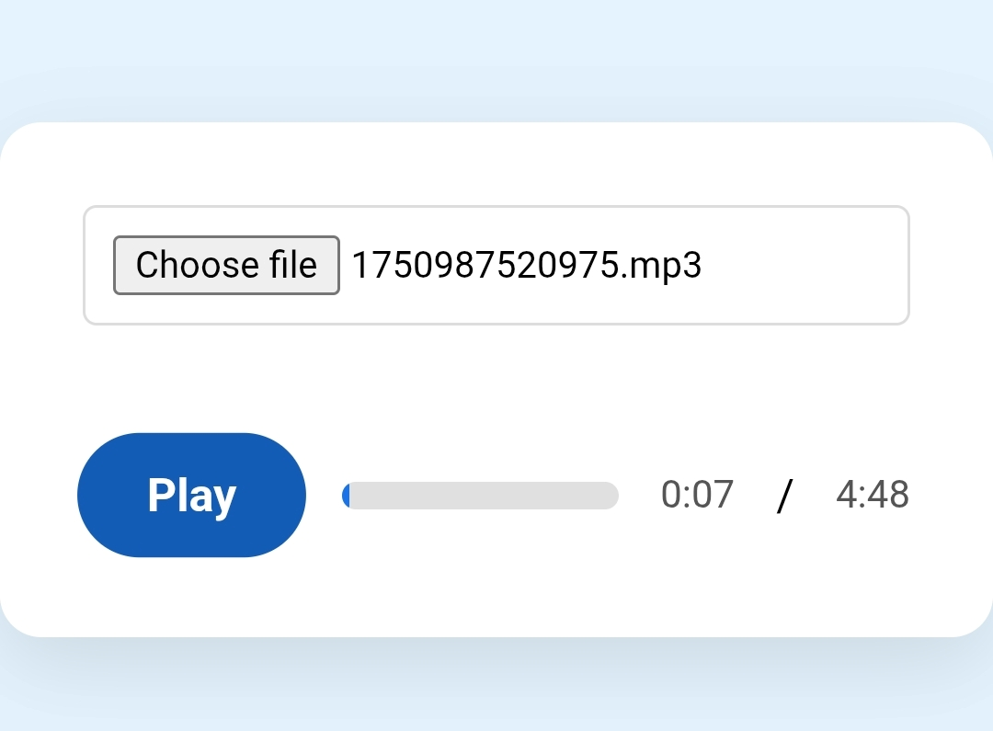
Results and Screenshots

Slide 11
Conclusion
We successfully built a functional and user-friendly audio player that addresses the need for a simple solution.
Potential Future Improvements:
Add volume control.
Implement a playlist feature.
Expand supported file types (e.g., WAV, Ogg).
Integrate a visualizer for the audio.

